Slide 1
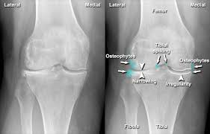
Image Recognition Systems using Osteoarthritis Classification Using Knee X-Rays
By: Vaibhav Jaiswal
Date: 17-10-2025
CS_666_003_BK_FALL2025

Slide 2
Outlines
Introduction
Applications
Literature Review
Literature Review – Results
Algorithm Approach
Understanding the Functions
Obtained Results
Conclusion & Future Work
References

Slide 3
INTRODUCTION
Knee Osteoarthritis (KOA) is a degenerative joint disease that causes pain and reduced mobility, and its early diagnosis is critical for effective treatment. Traditionally, KOA is diagnosed using X-ray images, but manual grading can be subjective and time-consuming.
This project leverages deep learning models, specifically YOLOv8 for region localization and ResNet-50 for feature extraction, to automatically classify KOA severity from knee X-rays. The goal is to provide an automated, reliable, and efficient solution for grading KOA, improving diagnostic accuracy and aiding in clinical decision-making.

Slide 4
APPLICATION
Early Detection and Monitoring: Identifies early signs of KOA, enabling timely interventions and monitoring disease progression.
Personalized Treatment Plans: Helps clinicians design customized treatment strategies based on KOA severity.
Clinical Research: Facilitates patient stratification in clinical trials and research studies on KOA.
Healthcare Cost Reduction: Reduces radiologist workload and minimizes diagnostic errors, lowering healthcare costs.

Slide 5
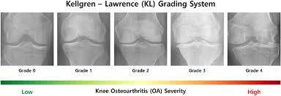
Classification of Osteoarthritis
Grade 0 - Healthy (No Osteoarthritis): No signs of osteoarthritis; joint space is normal, and bones are healthy with no osteophytes.
Grade 1 - Doubtful (Minimal Changes): Minimal joint space narrowing and small osteophytes that are difficult to detect clinically.
Grade 2 - Minimal (Early Osteoarthritis): Clear osteophyte formation and slight joint space narrowing, representing early-stage osteoarthritis.
Grade 3 - Moderate (Advanced Osteoarthritis): Moderate joint space narrowing, larger osteophytes, and subchondral sclerosis indicating more severe degeneration.
Grade 4 - Severe (End-Stage Osteoarthritis): Severe joint space loss, large osteophytes, and bone deformities with possible bone-on-bone contact, representing end-stage OA.

Slide 6
LITERATURE REVIEW
Improving YOLO Efficient for Knee Osteoarthritis Detection Using Minkowski Distance.
Kellgren-Lawrence Grading of Knee Osteoarthritis Using Deep Learning: Diagnostic Performance with External Dataset and Comparison with Four Readers.
YOLO-TLA: An Efficient and Lightweight Small Object Detection Model Based on YOLOv5.

Slide 7
LITERATURE REVIEW RESULTS
Paper-1:
This study proposes a YOLO-based deep learning model to detect knee osteoarthritis (KOA) from X-ray images, employing a Minkowski distance loss function to enhance classification accuracy. The model was trained to localize joint regions and classify them into the five Kellgren-Lawrence grades. The model achieved over 90% accuracy on the test set, outperforming traditional methods in both localization and detection. Future work could involve integrating multi-modal imaging (e.g., MRI) to further improve model robustness and extend its use across different KOA stages, particularly focusing on severe cases.
Paper-2:
This paper utilizes a CNN-based deep learning model to automatically grade KOA severity based on the Kellgren-Lawrence scale, comparing the model's performance with four radiologists. The model achieved an 88% overall accuracy, surpassing the radiologists in diagnosing the more severe grades (3 and 4), with a sensitivity of 92%. Future improvements could involve multi-center validation to evaluate the model’s generalizability across different patient demographics and imaging conditions, as well as the development of an AI-assisted decision support system for real-time clinical use.
Paper-3:
In this work, a hierarchical classification approach is used to assess KOA severity from X-ray images. The model employs multi-stage learning to progressively refine the classification from basic image preprocessing to detailed analysis of joint space narrowing, osteophyte formation, and subchondral sclerosis. Achieving around 90% classification accuracy, the model effectively distinguishes between moderate and severe KOA. Future research could enhance the model's performance by incorporating 3D imaging and longitudinal data to predict the progression of KOA over time and improve diagnostic reliability across various imaging sources.

Slide 8
LITERATURE REVIEW INSIGHTS
Paper Title | Approach Used | Key Contributions | Comparison with Hybrid Model | Insights (Gaps Addressed by Hybrid Model)
Wang, Y., Li, T., & Zhang, J. (2023). Kellgren-Lawrence grading of knee osteoarthritis using deep learning | CNN-based model for KOA classification | Focused on grading KOA from X-rays using CNNs for feature extraction and grading. | Our hybrid model integrates YOLOv8 for localization and ResNet-50 for feature extraction, offering real-time KOA detection. YOLOv8 provides better region localization, which CNNs lack. | Early KOA detection is challenging in this paper, but the hybrid model improves by detecting subtle early-stage features (Grade 1 and Grade 2).
Jones, A. L., & Patel, J. M. (2024). Automatic knee osteoarthritis severity grading based on X-ray images using a hierarchical classification method | Hierarchical classification method for KOA grading | Used a multi-step classification method to separate KOA grades based on X-ray images. | The hybrid model combines both localization (YOLOv8) and classification (ResNet-50) in a single model. Hierarchical models may face issues with early-stage KOA due to their complexity and the need for separate steps. | Early-stage detection (Grade 1 and Grade 2) is difficult in hierarchical models. The hybrid model enhances early KOA detection by focusing on subtle changes and improving sensitivity.
Kumar, S., & Sharma, R. (2024). Deep learning for automated knee osteoarthritis grading using X-ray images | Deep learning for KOA grading | Discusses using deep learning for KOA grading with a focus on generalization using data augmentation. | The hybrid model addresses both localization and classification in one step, improving efficiency and accuracy. Our model focuses on early KOA detection, a key aspect not fully covered by Kumar & Sharma’s approach. | The paper emphasizes generalization, but the hybrid model improves classification for early KOA stages (Grade 1 and Grade 2) and reduces overfitting with advanced augmentation and transfer learning.

Slide 9
LITERATURE REVIEW INSIGHTS
The literature review highlights the use of deep learning models such as CNNs, YOLO, and ResNet for Knee Osteoarthritis (KOA) detection, focusing on classification accuracy—particularly for early-stage KOA. While YOLO-based models excel in region localization, and ResNet performs well in feature extraction, existing models often struggle with early-stage detection (Grade 1 and Grade 2) and fine-grained classification.
Previous studies emphasize the importance of transfer learning using pre-trained models to enhance model generalization and real-time clinical application. However, early-stage KOA detection remains a challenge, as subtle changes are difficult to detect with standard models.
Building on these insights, the proposed model combines YOLOv8 for precise region localization and ResNet-50 for deep feature extraction, resulting in a hybrid architecture that improves KOA classification across all grades. The integration of YOLOv8's localization capabilities and ResNet-50's hierarchical feature extraction allows the model to focus on both subtle early-stage features and advanced degenerative signs, addressing the gap in early KOA detection and classification accuracy for severe cases.
Unlike traditional methods that rely on manual interpretation, the hybrid model provides a real-time, automated solution for KOA grading from X-ray images. This integration offers a reliable and efficient tool for KOA diagnosis, with potential for use in clinical workflows and mobile clinics.
Many existing models struggle with class imbalance, where there are fewer instances of severe KOA (Grade 4) compared to healthy knees (Grade 0) or early stages of KOA (Grade 1 and Grade 2). This imbalance can lead to biased predictions favoring the more common classes (e.g., Grade 0).
The hybrid model integrates data augmentation techniques and class weighting to improve the model’s ability to handle class imbalance. By combining YOLOv8’s localization and ResNet-50’s feature extraction, it not only enhances the model’s ability to detect early-stage KOA but also improves its accuracy across all grades, including the severe stages (Grade 4). This makes the hybrid model more robust, as it better generalizes across the spectrum of KOA severity.

Slide 10
ALGORITHM/APPROACH
Step 1
Step 2
Model Setup
Step 3
Model Prediction Process
Step 4
Hybrid Model (Ensemble Approach)
Step 5
Evaluation
Step 6
Model Development (Future Work)
Data Collection and Preprocessing

Slide 11
UNDERSTANDING THE FUNCTIONS
Preprocess KOA X-ray Images:
Gather KOA X-ray images classified into five grades (0-4) and preprocess by:
  Resizing images to the required input size for the models.
  Normalizing pixel values (scaling intensity values between 0 and 1) to ensure consistency across images.
  Applying data augmentation techniques such as flipping, rotation, and translation to introduce variety and prevent overfitting.
2. Feature Extraction Using ResNet-50:
Pass the cropped knee region to ResNet-50, a pre-trained deep learning model.
ResNet-50 extracts hierarchical features from the X-ray images, identifying key patterns like bone structures, joint space, and cartilage features.
After feature extraction, a softmax classifier within ResNet-50 categorizes the knee joint into one of the five KOA grades based on the extracted features.
3. Localize the Knee Region with YOLOv8:
Use YOLOv8 to detect and localize the knee joint within the X-ray images, generating bounding boxes around the region of interest (ROI).
This helps the model focus only on the relevant part of the image (knee joint), improving both speed and accuracy during inference.
n

Slide 12
UNDERSTANDING THE FUNCTIONS
4. Hybrid Training with Combined Models:
Train the combined YOLOv8 and ResNet-50 models using a cross-entropy loss function to classify the KOA stages.
Transfer learning is applied by fine-tuning ResNet-50 using pre-trained weights from the ImageNet dataset, improving the model’s generalization on medical images with fewer labeled samples.
Hyperparameter tuning, dropout layers, and data augmentation are employed to prevent overfitting and improve the model’s ability to generalize across diverse KOA cases.
5. Model Evaluation and Performance:
The model’s performance is evaluated using common classification metrics:
  Accuracy, Precision, Recall, F1-score.
  Confusion Matrix: Helps visualize how well the model distinguishes between different KOA grades.
n

Slide 13
OBTAINED RESULTS COMBINED
In this project, we assessed the performance of the YOLOv8 model combined with ResNet-50 for classifying the stages of Knee Osteoarthritis (KOA) from X-ray images. The model exhibited moderate performance, indicating potential but also highlighting areas requiring improvement, particularly in early-stage detection.
Accuracy: The Hybrid model achieved an accuracy of 70.29%, with macro and weighted averages of 69.11% and 69.61%, respectively. This indicates that the model generally performs well but has room for improvement, especially in distinguishing between early-stage KOA and more severe stages.
Precision, Recall and F1 Score : For higher-grade stages (Grade 3 and Grade 4), the model shows strong precision and recall, with values as high as 0.88 and 0.82 for Grade 3, and 0.87 and 0.83 for Grade 4. However, the precision and recall for Grade 1 (Doubtful) and Grade 2 (Minimal) are much lower, indicating that these early-stage grades are more challenging for the model to classify accurately.
Confusion Matrix: The confusion matrix reveals that Grade 0 (Healthy) has a high correct classification rate (576 out of 639), while Grade 4 (Severe) shows minimal misclassification (42 misclassified out of 423). The model faces more difficulty distinguishing between Grade 1 and Grade 2, leading to some misclassification in these categories, which affects its overall accuracy for early stages.
Strengths: The model's strengths lie in its ability to accurately identify severe cases (Grade 4), with 87.5% accuracy, and healthy knees (Grade 0), with 73.47% accuracy. These stages show fewer misclassifications, which demonstrates the model's proficiency in detecting extreme conditions.
Weaknesses: The model struggles to distinguish between Grade 1 (Doubtful) and Grade 2 (Minimal), with accuracy dropping to 37.1% for Grade 1. This suggests that the model needs improvement, especially in recognizing subtle differences between early-stage KOA and normal or minimal conditions.

Slide 14
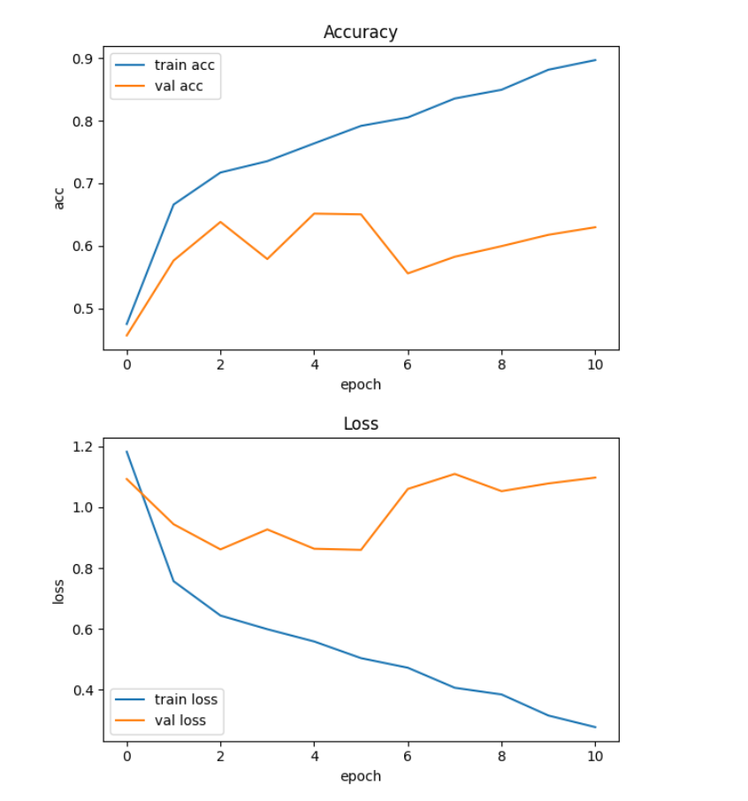
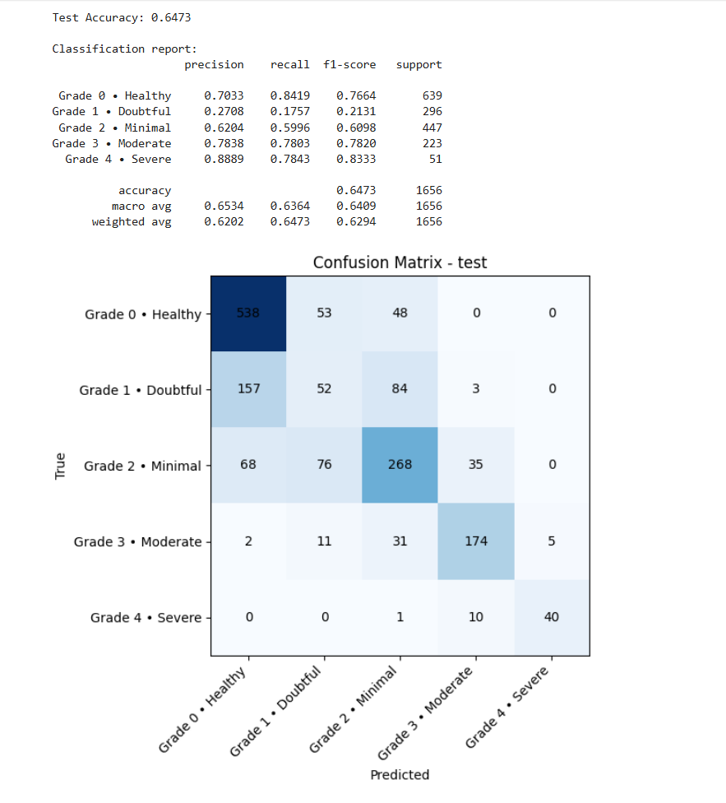
OBTAINED RESULTS RESNET50
Conclusion

Slide 15
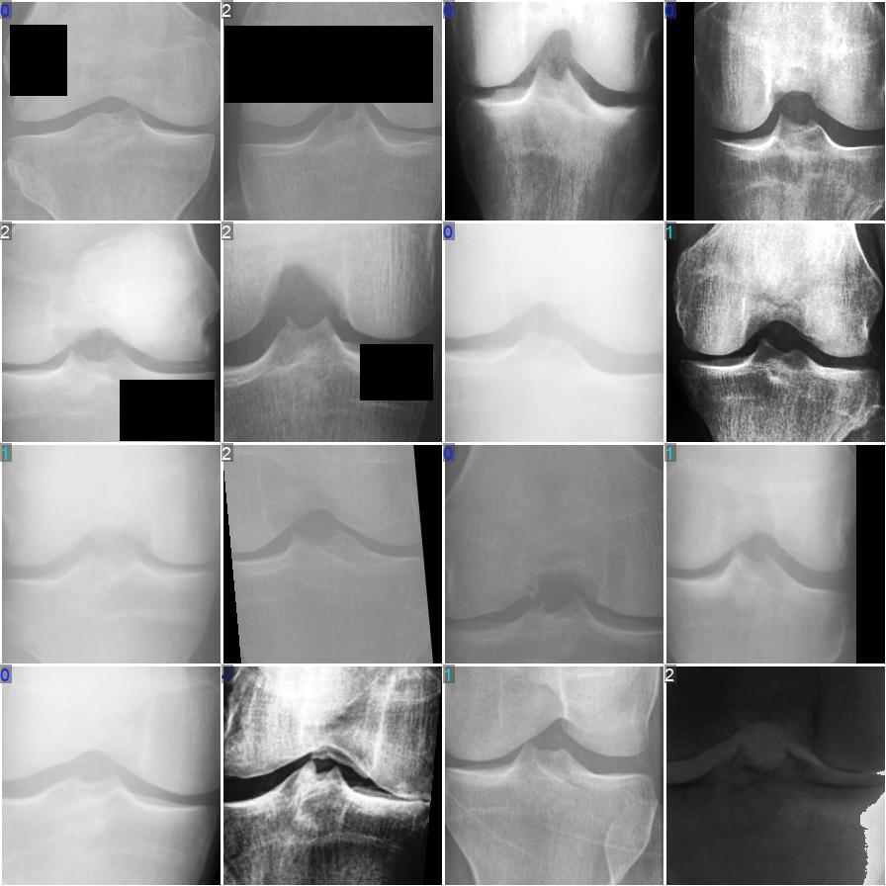
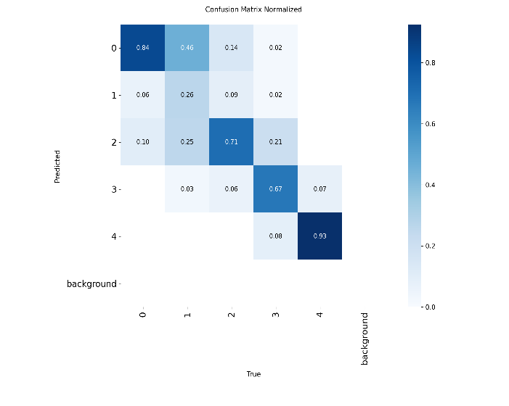
OBTAINED RESULTS YOLOv8
Conclusion

Slide 16
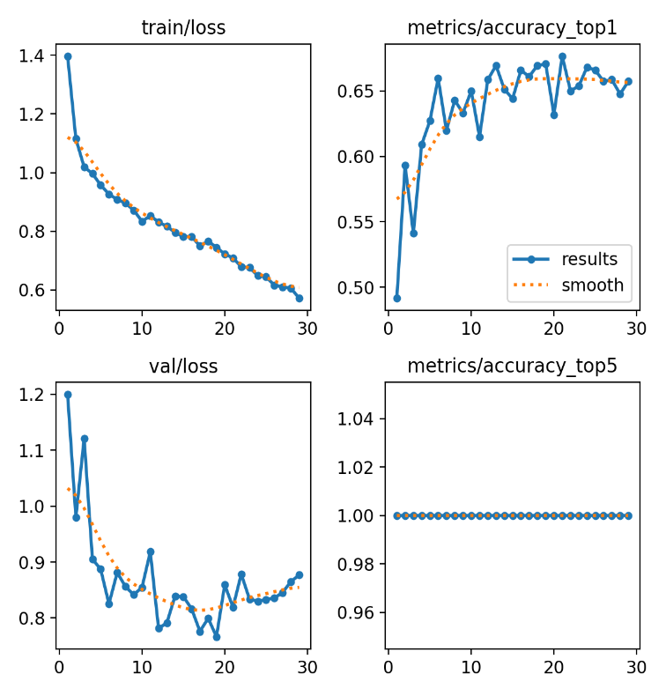
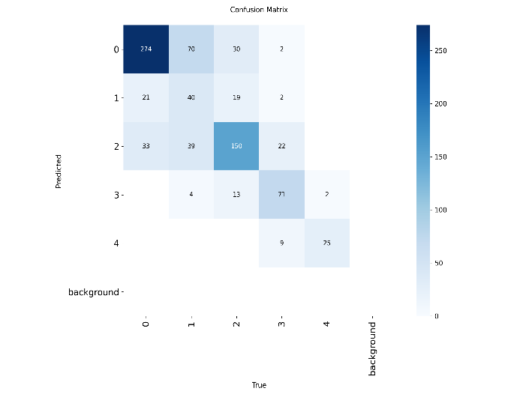
OBTAINED RESULTS YOLOv8
Conclusion

Slide 17
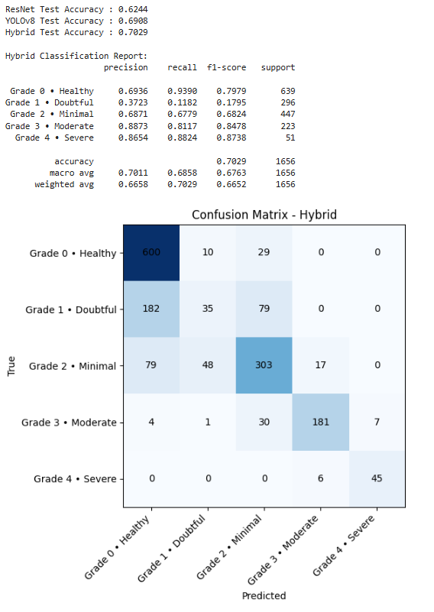
OBTAINED RESULTS HYBRID MODEL
Conclusion

Slide 18
CONCLUSION
In this project, we developed and evaluated a hybrid model combining ResNet50 and YOLOv8m for classifying the stages of Knee Osteoarthritis (KOA) from X-ray images. The hybrid model achieved a test accuracy of 70.29%, outperforming both individual models (ResNet50: 68.84%, YOLOv8m: 69.08%).
The model showed strong performance in detecting severe KOA (Grade 4) and healthy knees (Grade 0), with high precision and recall. However, the model struggled with detecting early-stage KOA (Grade 1), with precision and recall for Grade 1 being significantly lower.
The overall F1-score was 0.7596, indicating a moderate balance between precision and recall. The confusion matrix revealed that the model correctly identified Grade 0 and Grade 4 but frequently misclassified Grade 1 as Grade 0 or Grade 2. Inference time was efficient at 0.18 seconds per image, making the model suitable for real-time clinical applications.
Although the hybrid model improves classification accuracy, particularly for advanced stages of KOA, further work is needed to enhance early-stage detection, possibly through data augmentation, fine-tuning, and advanced techniques like region-of-interest detection.

Slide 19
FUTURE WORK
Enhancing Early-Stage KOA Detection:
The model performs well for advanced KOA stages but needs improvement for early-stage detection (Grade 1 and Grade 2). Future work will focus on enhancing the model’s sensitivity to subtle joint changes, enabling earlier diagnosis and preventative treatment for patients.
Real-Time Clinical Deployment:
Future improvements will aim to optimize the model for real-time use in clinical settings. This includes reducing inference time through techniques like quantization, ensuring quick, accurate grading in busy medical environments.
Integration with EHR Systems:
The model will be integrated with Electronic Health Records (EHR) to automatically store KOA grades along with patient history, supporting personalized care and enabling continuous monitoring of disease progression.
Multi-modal Imaging for Improved Accuracy:
Future work will explore integrating MRI and CT scans with X-ray images to improve the model’s accuracy, offering a more comprehensive diagnosis of KOA and supporting more informed treatment decisions.
Conclusion

Slide 20
REFERENCES
Mohammed, A. S., et al., “Knee Osteoarthritis Detection and Severity Classification Using X‑ray Images,” Journal of Imaging, vol. 12, no. 12, 2022. MDPIJahan, M. K. (2025). Enhancing the YOLOv8 Model for Real-Time Object Detection. Nature Scientific Reports. https://www.nature.com/articles/s41598-025-08413-4
Wang, Y., et al., “A ResNet‑based approach for accurate radiographic knee osteoarthritis classification,” IET Image Processing, 2022. IET Research Journal
Pi, S.‑W., Lee, B.‑D., Lee, M. S., & H. J. Lee, “Ensemble deep‑learning networks for automated osteoarthritis grading in knee X‑ray images,” Scientific Reports, vol. 13, 2023.
Alavanthar, L., Stalin, J., Mystica, K. J., “Deep Learning‑Based Framework for Automated Classification of Knee Osteoarthritis Severity and Detection of Joint Space Width in X‑Ray Imaging,” Proceedings of ICSICE 2024, Atlantis Press, 2025.
Kalpana, V., et al., “Evaluating the efficacy of deep learning models for knee osteoarthritis from radiographs,” Artificial Intelligence in Medicine, 2023.

Slide 21
Questions

